Slide 1
AUTOMATION BUILD IN AUTOMATION OF SOFTWARE DELIVERY PROCESS
NAME- ABHISHEK SINGH
ROLL NO- 03
SAPID-500061156

Slide 2
What is Automated build ?
Definition
In the context of software development, build refers to the process that converts files and other assets under the developers' responsibility into a software product in its final or consumable form. The build may include:
compiling source files
packaging compiled files into compressed formats (such as jar, zip)
producing installers
creating or updating of database schema or data
The build is automated when these steps are repeatable, require no direct human intervention, and can be performed at any time with no information other than what is stored in the source code control repository.

Slide 3

Built automation and Continuous integration

Slide 4
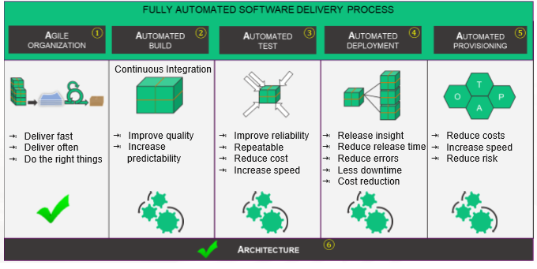

Slide 5
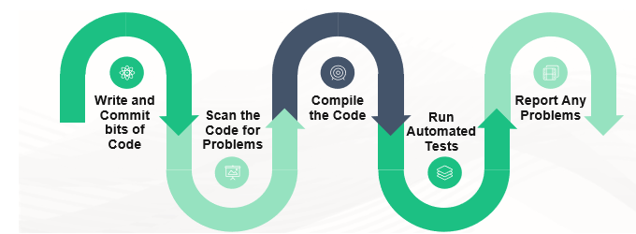
The Build process

Slide 6
Build Process Steps
Step 1: Write and Commit bits of Code
Let’s say one of our programmers is busy designing your individualized application on his/her own computer. Red light! What happens if the system crashes? Vast amounts of work may be lost forever. So instead, we commit (or upload) the code to a central source code repository. Imagine this repository as a holding zone, a database for our code.

Slide 7
Step 2: Scan the Code for Problems
With the code in the repository, we then scan it for common problems. There are a variety of tools available for this, based on programming language used, in our projects JSHint, FxCop and Code Duplication Checkers are some of the most commonly used. We like scanners because they can automatically monitor the code before we deploy it.

Slide 8
Step 3: Compile the Code
We compile the code after we’ve scanned it. In this step we change the programmer’s commands into something that works on your desktop, mobile device or web browser. Here we also use scripts to create the database tables, test data and stored procedures

Slide 9
Step 4: Run Automated Tests
Finally, we’re ready for the automated tests. For instance, if we’re working with a website application, scripts load the browser automatically, land on a specific page, and test how things work on that page. Typically, there are hundreds of automated tests for a given application. The quality of the application is vastly improved because the automated tests run daily.

Slide 10
Step 5: Report Any Problems
When automated tests detect a problem, our team receives immediate notification in order to swiftly repair it. The result is essentially bug free code throughout the development process. When our manual testers discover new issues, we develop a new automated test expressly for that issue. Selenium is our preferred software testing framework for user interface automated tests

Slide 11
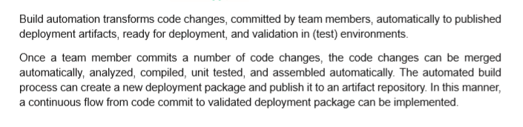
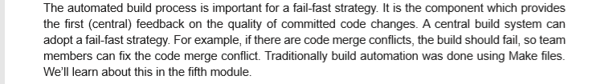
Automated Build

Slide 12
Expected Benefits
Build automation is a prerequisite to effective use of continuous integration. However, it brings benefits of its own:
eliminating a source of variation, and thus of defects; a manual build process containing a large number of necessary steps offers as many opportunities to make mistakes
requiring thorough documentation of assumptions about the target environment, and of dependencies on third party products

